Slide 1
A Campus of Gender Equity
(for Residential College)
性別平等的校園 (書院專用)

Slide 2
The University of Macau is committed to providing a safe, healthy, and gender-friendly environment for academic and career pursuits, by sharing with all staff and students the University’s views on professional conducts and gender equity.
澳門大學提倡專業操守和性別平等的理念，以致力為教職員及學生提供安全、健康及性別友好的學習和工作環境。

Slide 3
Agree or Not? 你同意嗎?
Sexual harassment education is important because women needs to be shown how to be around men. 性教育很重要，因為要讓女士知道怎樣與男士相處。
I am just being friendly, it is not ‘sexual harassment’. 我這樣只是友善的行為，並不是 ‘性騷擾’。
If I am around people I know well then I will be safe from sexual harassment. 如果我周遭的都是熟悉的人，我就不會受到性騷擾。
3

Slide 4
Gender Equity 性別平等
It is essential that all the University members respect one another to maintain an academic and work environment that is free from sexual harassment and sexual bullying.
The University has zero tolerance of sexual harassment and sexual bullying and will take prompt disciplinary action where the case is substantiated or report to the police.
大學全體成員應當相互尊重，大學應當維護其性別平等的學術及工作環境，使學生及員工免受性騷擾和性霸凌等行為的侵害。
大學絕不容忍性騷擾和性霸凌等行為。若相關投訴獲證實，大學將及時開展紀律程序，實施紀律處分或向警察報案。

Slide 5
Gender Relationships on Campus
校園內的性別關係
Gender Relationships: 性別關係：
Male and Female 男與女 Male and Male 男與男 Female and Female 女與女
Gender Relationships on Campus: 校園性別關係：
Classmates, Teacher-student, Staff 校內同學之間、師生之間、教職員之間的互動相處
5

Slide 6
Two Principles of Gender Relationships
性別關係的兩項基本原則
性別平等 (Gender Equality)
性別相互尊重 (Gender Mutual Respect)
6

Slide 7
Campus Life and Gender Respect
校園生活與性別尊重
Gender respect for a multi-cultural campus: 指在多元文化的學校生活中學習性別尊重：
Understand and respect other people’s cultural identities, help classmates / staff from different cultural background get adjusted to campus life 認識和懂得尊重別人的文化特徵，協助來自不同文化背景的同學 / 教職員融入學校的生活
Respect the individual classmate / staff’s unique sexual orientation and characteristics 尊重個別同學 / 教職員獨特的性別取向與角色表現
Help create a campus for individual classmate / staff to freely and responsibly develop oneselves 協力創造每個同學 / 教職員都可以自由學習和發揮潛能的校園
7

Slide 8
Gender Relationship and Sexual Harassment on Campus
校園性別關係及性騷擾
There are lots of members on campus who are from different societies and cultural backgrounds, our basic responsibility is to respect each other, be it working with people of the same sex or opposite sex. 大學內成員眾多，來自不同的社會和文化背景，在不同性別的交往中需要互相尊重、平等相處。
Each member need to be mindful of his/her own words and actions to avoid having inappropriate behaviors related to sexual harassment. 每一成員應注意自己的言行，避免作出不恰當的性騷擾行徑。
Every single person is expected make the effort of creating a safe campus without sexual harassment. 希望每個人都出一分力去締造一個沒有性騷擾的校園。
8

Slide 9
Sexual Harassment 性騷擾
Sexual Harassment is an unwelcomed or unwanted conduct of sexual nature, including unwelcome sexual advances, requests for sexual favors, and other verbal, non-verbal, visual, or physical conduct of sexual nature.
性騷擾是指不受歡迎或不為他人接受的、並且與性有關的行為，包括不受歡迎的性挑逗、性要求及其他語言、非語言、視覺或肢體上的性暗示行為。

Slide 10
Sexual Bullying 性霸凌
Sexual Bullying is any coercive behavior or act against somebody, through the use of any tool, technological or otherwise, based on or by taking advantage of their sexuality or gender regardless whether the behavior or act in question is physical, verbal or otherwise and regardless whether it is carried out in their presence or absence.
性霸凌是指通過科技或其他工具，基於或利用他人的性取向或性別而對其作出的脅迫行為，不論是肢體、言語還是其他方面的行為，也不論當事人是否在場。

Slide 11
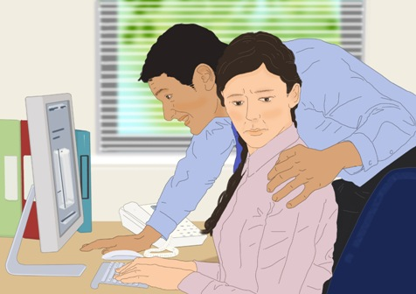
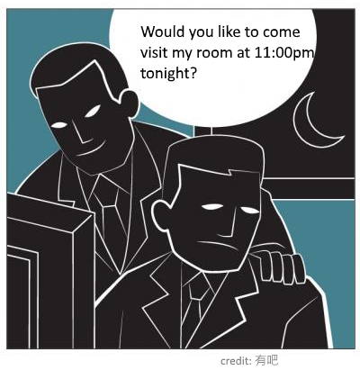
Behaviors of sexual nature
涉及性的行徑
Behaviors involved with sexual element or implication including: 帶有性的成分、色彩或含意的行徑，可以包括：
Physical 身體動作
Visual 視覺上
Verbal 言語上
Implicit and indirect behaviors 隱晦和間接的行為
Deliberate or undeliberate behaviors 刻意或不經意的行為
Once or frequent behaviors 一次或經常的行為
11

Slide 12
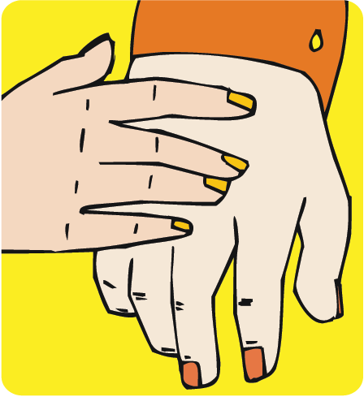
Common Forms of Sexual Harassment
常見的性騷擾形式
Physical: Touching, grabbing or deliberately brushing up against another person 身體接觸：如搭肩膊、掃背、搓手
Verbal: Sex-related jokes or comments 言語接觸：如色情笑話、與性有關的評論
Non-verbal: staring, indecency or lewd gestures 非言語的行為：如挑逗或淫褻動作
Threats for sex: Affect a person’s career or academic status 以性作為要脅的行為：影響事業或成績
Hostile or intimidating environment 敵意或具威嚇性的環境
12

Slide 13
Examples of Sexual Harassment
性騷擾的例子
13

Slide 14
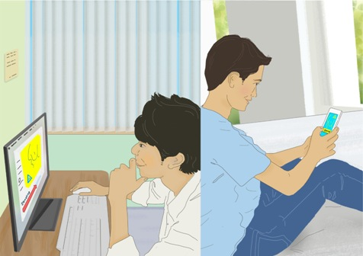
Offensive materials of a sexual nature
使人反感的涉及性的通訊資料
A student downloads some pornographic photos from the internet and forwards them to other students without their permission.
某同學在網上下載了一些不雅照片，並把該些照片轉載給其他同學，而之前是沒有獲對方同意的。
Unwanted!
不為他人接受!
14

Slide 15
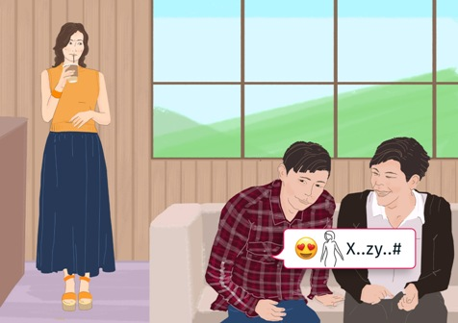
Comments with sexual innuendoes
帶有性方面影射的評論
A few students telling sex-related jokes and making disparaging remarks about the female body, in the presence of other classmates. The classmates find it unpleasant and highly offensive.
一些同學以黃色笑話為話題，更把女性的身材作為笑柄，令其他在場的同學感到不安和侮辱。
Unwelcomed!
不受歡迎!
15

Slide 16
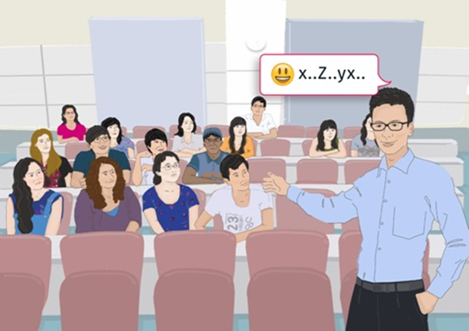
Sexual comments or jokes
帶有性的評論或笑話
An academic staff using sexually suggestive jokes in academic events (e.g. lecture, student activities) which is unrelated to sex, this makes the students in feel uncomfortable and embarrassed.
某教師在學術活動上(如授課,學生活動等)，用帶有性含義的笑話教授與性無關的課題，使在場學生感到十分不舒服及尷尬。
Inappropriate!
不恰當!
16

Slide 17
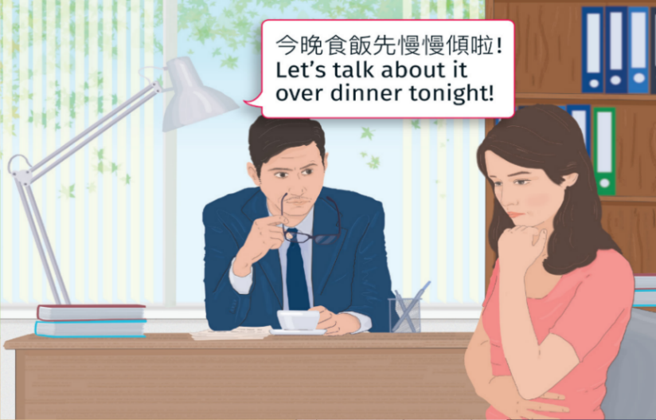
Sexual propositions or other pressure for sex
性方面的提議，或是給予對方壓力來達到性的要求
A student is discussing the Master’s thesis with his/her supervisor. The thesis supervisor suddenly asks the student for a date. When the student declines, he/she drops hints that the student may regret it if the student does not comply to his/her request.
學生請教教授有關碩士論文的問題時，教授竟忽然要求約會，同時暗示若拒絕他，後果自負。
Coercive!
脅迫!
17

Slide 18
Video Sharing 短片分享
https://policy-harass.cuhk.edu.hk/images/Content/one-minute-videos/cantonese/Conversation_CAN.mp4
18

Slide 19
Sexual Harassment & Cyber Age

Slide 20
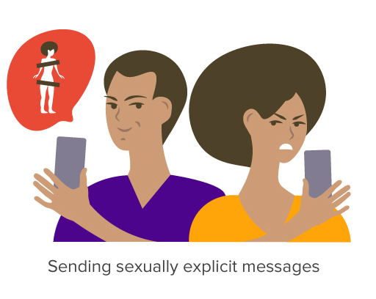
Sending sexually explicit messages
A student sends messages to another student containing sexual content (images, emojis, messages)

Slide 21
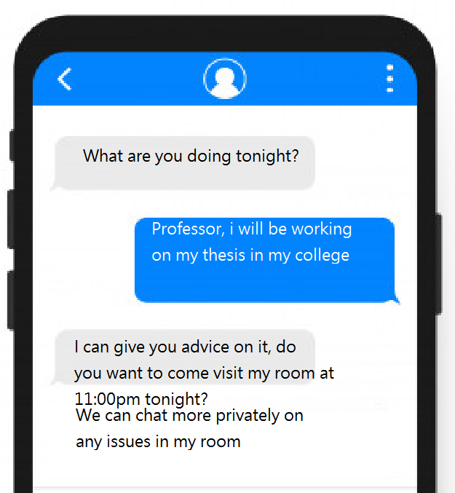
Requesting private chats of seductive nature
An academic staff is inviting his student to visit his room/apartment at inappropriate timeslot, requesting private chat

Slide 22
Inappropriate behaviour in online learning environment
A student is dressing in sexually offensive manner in zoom sessions

Slide 23
Myths about Sexual Harassment
一般人對性騷擾的誤解
Sexual harassment only happens to women, men are safe. 性騷擾事件只會發生在女性身上，男性不可能會被性騷擾。
People who engages in sexual harassment is absolutely ‘lustful’ and ‘abnormal’. 性騷擾的人一定是「咸濕」、「變態」的。
I have the right to express my love, it is not ‘sexual harassment’. 我只是表達愛意，哪有「性騷擾」?
Sexual Harassment usually happens with unfamiliar people. 性騷擾多發生在陌生人間。
23

Slide 24
Myths about Sexual Harassment
一般人對性騷擾的誤解
When a person put on a sexy outfit or seemingly overly enthusiastic to other people would be an encouragement for sexual harassment, so he/she has to take part of responsibilities. 衣著打扮較性感或行為舉止較熱情的人有鼓勵別人犯罪之嫌，所以他/她亦需負上部分責任。
People usually make sexual jokes just for show off their humorous side, he/she has no intention to offend or harass other people. 別人大談黃色笑話，只為突顯個人的幽默感，並沒有任何冒犯或騷擾他人的意圖。
The consequences of sex harassment are less serious than sexual assault. Making a complaint may be taunted by other people so it is better not make a fuss over it. 性騷擾的後果並沒有像性侵犯般嚴重，舉報的話別人可能會出言奚落，所以無謂小題大做。
24

Slide 25
It is all about respecting yourself and others…
尊重自己和別人…
Prevention is the Best Policy
預防是最好的措施

Slide 26
Protect Yourself and Seek Help
自我保護及求助
Say “NO” to any sexual harassment or sexual bullying. 請明確地拒絕對方。
Be calm and collect evidence about the incident, seek help and report it immediately. 請保持冷靜、保留證據、盡快尋求協助，並立即提出投訴。
Try to choose a suitable public place for the one to one meeting with your colleague or student. If not possible, keep the door of the office open or ask to leave it open while the meeting is on.
與同事或學生單獨會面時，盡量選擇適當的公共場所； 如果在辦公室會面，則將房門打開或者要求對方將房門打開。
Notes:
What you can do when facing sexual harassment or sexual bullying:
Say “no” to any sexual harassment or sexual bullying.
Be calm and collect evidence about the incident, seek help and report it immediately to the Committee on Gender Equity, through respective your Unit Head or the Gender Equity Officer.
It is normal that you may feel nervous and helpless when such an incident occurs to you. Seek help from respective unit head, the Gender Equity Officer or someone you can trust.
A friendly tip: Try to choose a suitable public place for the one to one meeting with your colleague or student. If not possible, keep the door of the office open or ask to leave it open while the meeting is on.

Slide 27
Reference in Macau Penal Code
根據澳門刑法典
Sexual harassment (semi-public crime, Article 164-A) & other sexual crimes – newly written into the stipulation
性騷擾罪（屬於半公罪，第164-A條）已被引入刑法典。
使他人被迫忍受性方面的身體接觸，或迫使他人與行為人或第三人進行此行為而騷擾他人者，不論是以身體某部分或物件作接觸，如按其他法律的規定不科處更重刑罰，則處最高一年徒刑，或科最高一百二十日罰金。
Forcing others to tolerate sexual physical contact, or forcing others to do this with the perpetrator or a third person to harass others, regardless the contact is with a certain part of the body or an object, the penalty is up to one year’s imprisonment or a fine of up to 120 days if no more severe penalty is imposed according to other laws.
Notes:
性騷擾罪也已於2017年8月26日正式被引入澳門的刑法典 (第164-A條),屬於半公罪, 經被害人提告可進行刑事訴訟, 所以校園性騷擾行為不謹會被學校處分, 也是犯法, 要負上刑事責任.

Slide 28
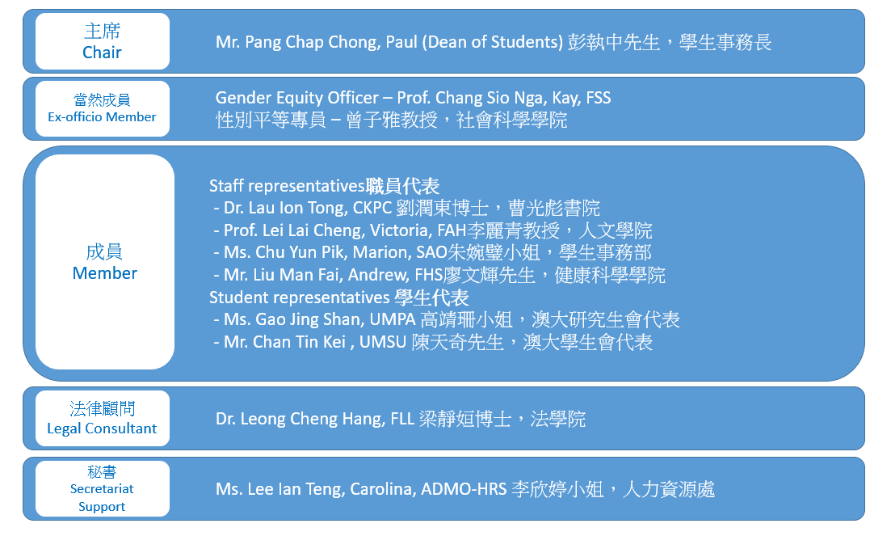
Committee on Gender Equity
Effective on 生效於 6 Mar 2021
Notes:
The Committee on Gender Equity (CGE) was established to promote gender equity in the University. Led by the Rector, the CGE is composed of the representatives of academic staff, administrative staff and students.

Slide 29
Committee on Gender Equity 性別平等委員會
Terms of Reference 職權
To promote gender equity in the University by way of publicity, education or any other means. 通過宣傳和教育及其他方式推動大學的性別平等；
To monitor the situation of gender equity in the University and assist in the investigation and handling of complaints when necessary. 監督大學的性別平等狀況，並在有需要時協助調查及處理投訴；
To devise, review and modify the guidelines, for handling the gender equity issues or any other related guidelines. 制定、檢討及修訂處理性別平等事務的指引或其他有關指引；
To assist in instituting and implementing the University’s gender equity initiatives. 協助制定及實施大學的性別平等計劃。
Email 電郵: gender_equity@um.edu.mo │ Webpage 網頁: https://cge.um.edu.mo/

Slide 30
性別平等專員
Gender Equity Officer GE_Officer@um.edu.mo
________________________________________________
To provide information and advice to staff members and students with the objective of effecting a gender equity environment on campus; 向職員和學生提供性別平等的資訊和建議，締造性別平等的校園；
To entertain formal complaint from any staff member or student who believes that he or she has been or is being sexually harassed or bullied; 處理職員或學生的性騷擾或性霸凌投訴；
To provide the complainant information and advice on the options and procedures of lodging a formal complaint including reporting to the police if the conduct under complaint appears to have constituted a criminal offence; 向投訴人提供處理投訴的程序的資訊和建議，包括當涉及的行為可能構成刑事犯罪，向警方報案；
To require all units in the University to report received complaints and offers advice on handling them. The Gender Equity Officer shall file all the complaints received which meet the required conditions; 向大學各單位所報告的投訴提供處理方法的建議。若有關投訴符合立案條件，則正式立案；
To attend the CGE meetings as an ex-officio member. 作為當然委員出席性別平等委員會會議。

Slide 31
Procedures for Lodging Complaints about Sexual Harassment and Bullying
處理性騷擾和性霸凌的投訴程序
The complainant reports the incident to the Unit Head / Gender Equity Officer verbally or in writing
以書面或口頭形式向部門主管/性別平等專員提出投訴
The Gender Equity Officer receives the complaint
性別平等專員接收投訴個案
The Gender Equity Officer reports the complaint and provides recommendations to the CGE
性別平等專員向性別平等委員會報告投訴個案及提出建議
The CGE conducts a preliminary investigation and provides recommendations to the Rector, who shall decide on the appropriate action to be taken
性別平等委員會進行初步調查，並向校長提出建議，由校長決定應採取之行動
The Gender Equity Officer shall inform the complainant of the decision
性別平等專員應將有關決定通知投訴人
Notes:
For any complaints about sexual harassment and bullying, staff may report the incident to the Gender Equity Officer or Unit Head verbally or in written. Once the Officer receives the complaint, it will be raised to the Committee on Gender Equity with recommendations. The Committee will then conduct a preliminary investigation, and will provide recommendations to the Rector, who shall decide on the appropriate action to be taken. The Gender Equity Officer shall inform the complainant of the decision.
All records and documents related to the complaints will be treated with strict confidentiality.

Slide 32
Stipulations established by UM
澳門大學的條文
The Personnel Statute of the UM
澳門大學人員通則
Article 12 Obligations of Personnel 第十二條 工作人員的義務
The obligations of the UM staff members shall be: 1) Respecting and treating with civility both superiors and
subordinates, colleagues and all other persons who have
relations with UM;
1. 澳大工作人員的義務為：
（ 一） 尊重並以禮對待其上級、下屬、同事及與澳大有聯繫
或正建立聯繫的其他人士；

Slide 33
Stipulations established by UM 澳門大學的條文
Guidelines on the Professional Conduct for
the Academic Staff of the UM
II. Ethical Commitments
2.2 Deal with students respectfully and fairly without discrimination of any kind.
2.3 Exercise due care for students and pay close attention to their whole person development.
2.10 Avoid placing students in situations which may unnecessarily cause them embarrassment.
澳門大學教學人員專業操守指引
II. 道德承諾 2.2 尊重並公平對待學生，不應對學生有任何歧視。 2.3 關心學生成長，重視其全人發展。 2.10 避免對學生造成不必要的尷尬。
Guidelines for Handling Sexual Harassment and Sexual Bullying Cases of the UM
性騷擾及性霸凌個案處理指引

Slide 34
Stipulations established by UM
澳門大學的條文
All related guidelines echo our educational ideal as conceived in our University Motto –
所有相關指引都與大學校訓中所提倡的教育理念相呼應 –
Humanity 仁
Integrity 義
Propriety 禮
Wisdom 知
Sincerity 信

Slide 35
UM is a place where we learn, work, and grow together, let’s have a campus of gender equity. 澳門大學是我們一起學習，工作和成長的地方，讓我們共同締做一個性別平等的校園。
35
Notes:
The bottom line is that UM has zero tolerance for sexual harassment and sexual bullying. So, don’t do it, and report it if it ever happens. Wish you an enjoyable journey at UM! Thank you.

Slide 36
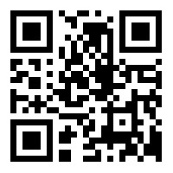
Contact Points 聯絡方式
Committee on Gender Equity (CGE)
性別平等委員會
Email 電郵: gender_equity@um.edu.mo
Webpage 網頁: https://cge.um.edu.mo/
Gender Equity Officer
性別平等專員
Email 電郵: GE_Officer@um.edu.mo
Notes:
For more information about the Guidelines, Complaint Procedures, Tips and other related information on gender equity, please refer to our Pamphlets.

Slide 37
Q & A

Slide 38
What if 如果…
What if I am not the parties involved but I only witnessed or observed unwelcomed and inappropriate sexual behaviors happened on campus? 如果我不是當事人，我只是在校園裡目睹或發現不恰當的性行為，我該怎樣做 ？
What if another person thinks he/she was insulted, offended or threatened by me (intentional or unintentional)? 如果有人認為我侮辱，冒犯或威嚇了他/她（有意或無意），我該怎樣做？
…Should face the problem seriously and consider his/her feeling, meanwhile stop the behaviors and extend a sincere apology. …我應該認真面對問題，考慮他/她的感受，停止有關行為，並真心道歉。
What if the person I am interested in did not say “No” to me, that is an automatic “Yes”? 如果我有好感的那個人沒有對我說“不願意”，即代表他/她“願意”？
38

