Slide 1
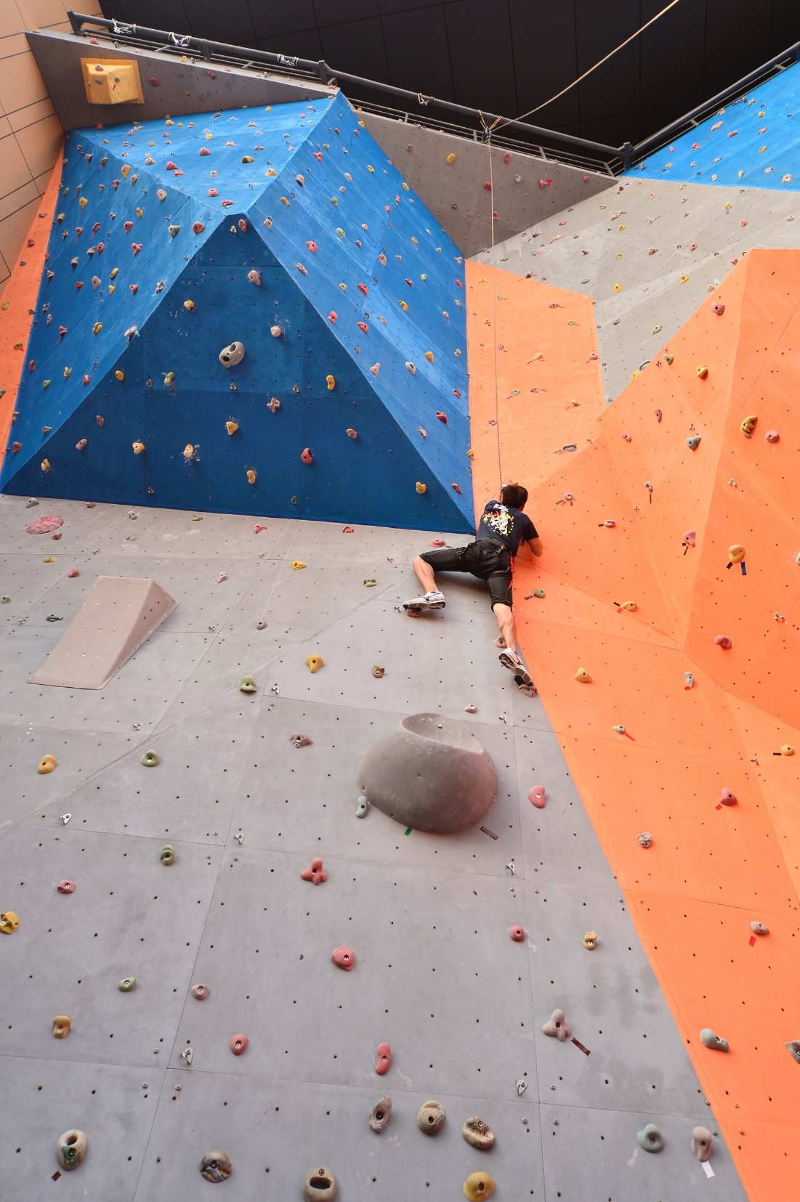
A Campus of Gender Equity
性別平等的校園
Prof. Ming-Chuen YIP 葉銘泉教授 Committee on Gender Equity 性別平等委員會
August 2019

Slide 2
Gender Equity 性別平等
A Campus of Gender Equity
性別平等的校園

Slide 3
Gender Equity 性別平等
It is essential that all the University members respect one another and the University strives to maintain an academic and work environment that is free from sexual harassment and sexual bullying.
The University has zero tolerance of sexual harassment and sexual bullying and will take prompt legal and disciplinary action where the case is substantiated.
大學全體成員應當相互尊重，大學應當維護其性別平等的學術及工作環境，使學生及員工免受性騷擾和性霸凌等行為的侵害。
大學絕不容忍性騷擾和性霸凌等行為。若相關投訴獲證實，大學將及時開展紀律程序，實施法律及紀律處分。

Slide 4
Gender Equity 性別平等
Sexual harassment is an unwelcome or unwanted conduct of sexual nature, including unwelcome sexual advances, requests for sexual favors, and other verbal, non-verbal, visual, or physical conduct of sexual nature.
性騷擾是指不受歡迎或不為他人接受的、並且與性有關的行為，包括不受歡迎的性挑逗、性要求及其他語言、非語言、視覺或肢體上的性暗示行為。

Slide 5
Gender Equity 性別平等
Sexual bullying is any coercive behavior or act against somebody, through the use of any tool, technological or otherwise, based on or by taking advantage of their sexuality or gender regardless whether the behavior or act in question is physical, verbal or otherwise and regardless whether it is carried out in their presence or absence.
性霸凌是指通過科技或其他工具，基於或利用他人的性取向或性別而對其作出的脅迫行為，不論是肢體、言語還是其他方面的行為，也不論當事人是否在場。

Slide 6
Gender Equity 性別平等
Protecting Yourself and Seeking Help
Say “no” to any sexual harassment or sexual bullying.
Be calm and collect evidence about the incident, seek help and report it immediately.
如何自我保護及求助？
請明確地拒絕對方。
保持冷靜、保留證據、盡快尋求協助及提出投訴。

Slide 7
The complainant reports the incident to the Unit Head / Gender Equity Officer verbally or in writing
以書面或口頭形式向部門主管/性別平等專員提出投訴
Procedures for Lodging Complaints about Sexual Harassment and Sexual Bullying
性騷擾及性霸凌投訴程序
The Gender Equity Officer receives the complaint
性別平等專員接收投訴個案
The Gender Equity Officer reports the complaint and provides recommendations to the CGE
性別平等專員向性別平等委員會報告投訴個案及提出建議
The CGE conducts a preliminary investigation and provides recommendations to the Rector, who shall decide on the appropriate action to be taken
性別平等委員會進行初步調查，並向校長提出建議，由校長決定應採取之行動
The Gender Equity Officer shall inform the complainant of the decision
性別平等專員應將有關決定通知投訴人

Slide 8
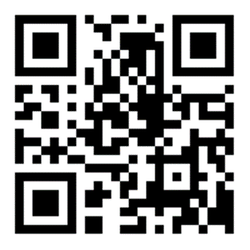
Gender Equity 性別平等
Committee on Gender Equity (CGE)
性別平等委員會
Email: gender_equity@um.edu.mo
Webpage: http://www.um.edu.mo/cge
Gender Equity Officer
性別平等專員
Email: GE_Officer@um.edu.mo

Slide 9
It is all about respect to yourself and others…
尊重自己和別人…
Prevention is the Best Policy
預防是最好的策略

Slide 10
UM is a place where we learn, work, and grow together, let’s have a campus of gender equity. 澳大是我們共同學習、工作生活及成長的地方，讓我們為維護性別平等的校園而努力。

