Slide 1
THE CHINESE UNIVERSITY OF HONG KONG
The Committee Against Sexual Harassment
Ms. Yvonne Luk
Secretary
Committee Against Sexual Harassment

Slide 2
Content
CUHK’s Policy Against Sexual Harassment
Organization of Committee Against Sexual Harassment
Our Work
Publicity and Education

Slide 3
Policy Against Sexual Harassment
To eliminate and prevent sexual harassment, the University:
Formulated a Policy Against Sexual Harassment in 1995
Clearly state the University’s stance on sexual harassment
Set out the mechanism for dealing with allegations or complaints of sexual harassment

Slide 4
Policy Against Sexual Harassment
Definition and examples of sexual harassment
Rights of victim (i.e. prevention of victimization)
Principles of handling sexual harassment complaints (e.g. fairness, confidentiality, avoid delay, avoid conflict of interest, etc.)
Mechanism for handling sexual harassment complaints (i.e. conciliation, investigation and appeal procedures)

Slide 5
Policy Against Sexual Harassment
Time bar for lodging a complaint
Formal disciplinary procedures
Measures for prevention of sexual harassment (e.g. regular review of the policy and measures, regular training, designate staff members to implement the measures, etc.)

Slide 6
Committee Against Sexual Harassment
To review statistics on sexual harassment and the complaint procedures
To oversee education matters relating to sexual harassment within the campus
To conduct periodic review of the Policy Against Sexual Harassment

Slide 7
Organization Chart
Committee Against Sexual Harassment
Chairperson
Panel Against Sexual Harassment
Task Force on Education and Training
Convenor
Convenor
Members
Secretary
Members
Secretary
Members

Slide 8
Panel Against Sexual Harassment
Responsible for conciliation and complaint investigation of cases involving staff members and students
At least two panelists of different genders appointed by the Panel Convenor
Undertake regular training in relation to sexual harassment

Slide 9
Task Force on Education and Training
Responsible for promoting awareness of the need to prevent sexual harassment
Organise educational and promotional programmes and activities for members of the University community
Review the promotional and educational strategies periodically
Sexual Harassment

Slide 10
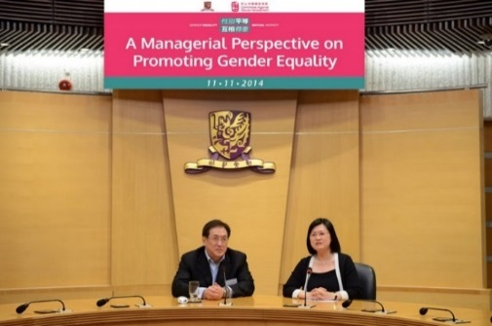
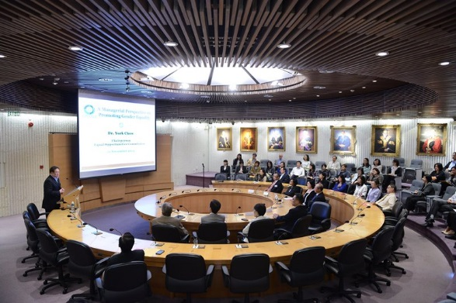
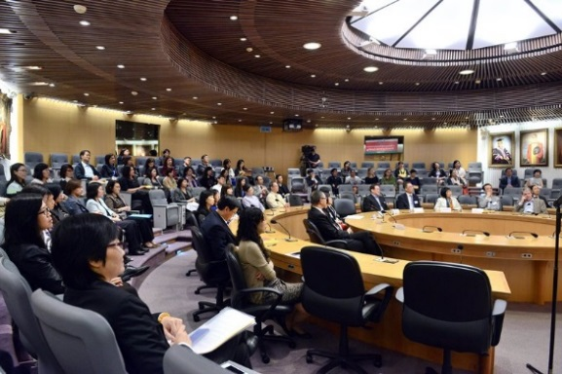
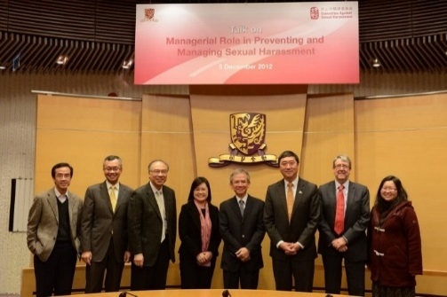
Training Programmes for Staff Members
In-house Seminars
Forums / Talks / Workshops

Slide 11
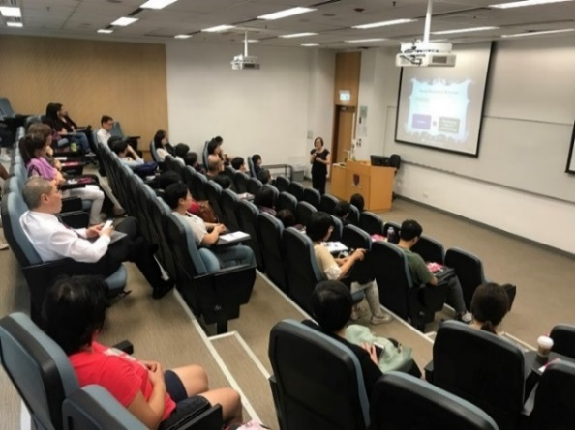
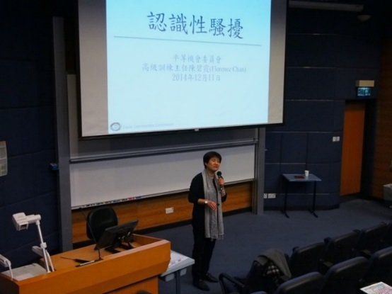
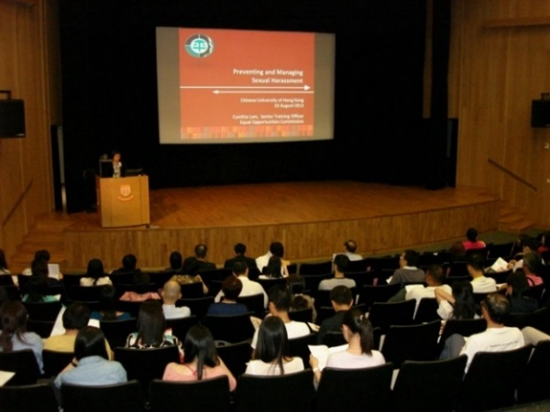
Training Programmes for Staff Members
Induction Talks for New Staff
Online Training Module

Slide 12
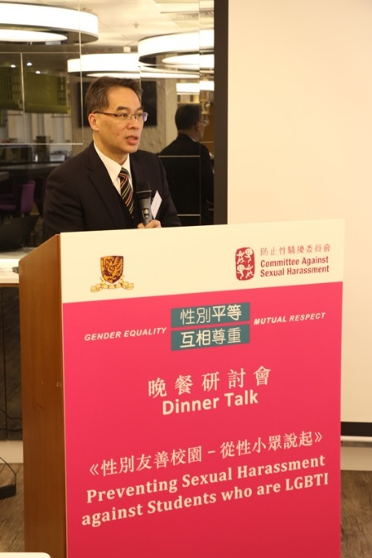
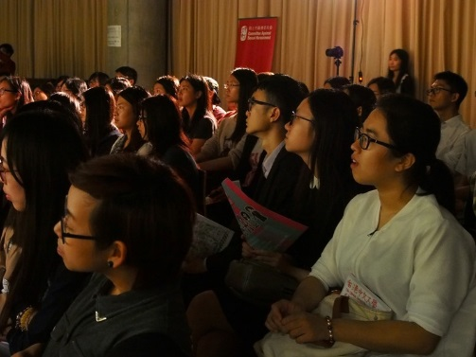
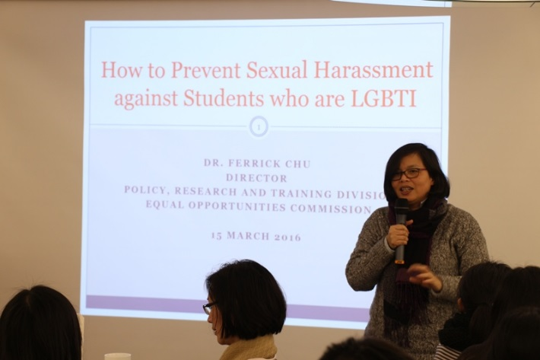
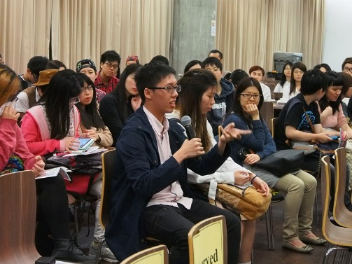
Awareness Training for Students
Orientation Talks
Dinner Talks
College Assembly Talks

Slide 13
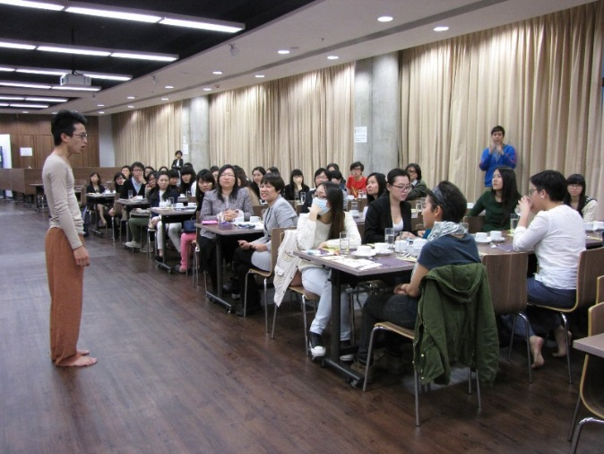
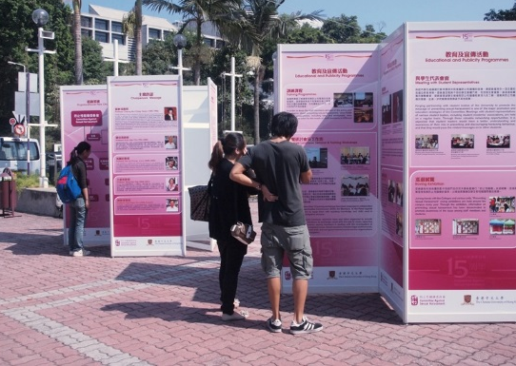
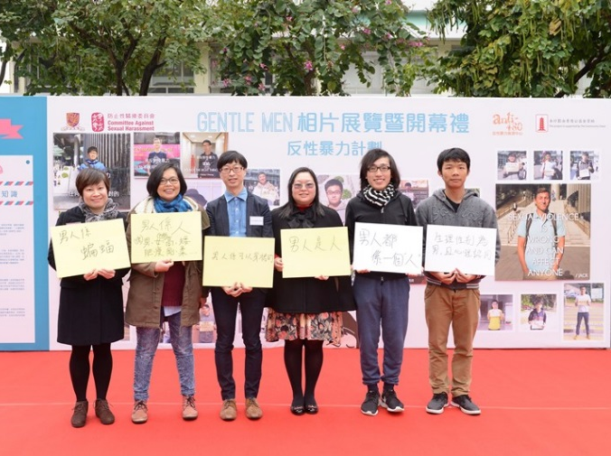
Awareness Training for Students
Ambassador Scheme
Film Show / Drama Performance
Roving Exhibition
Sponsorship Programme

Slide 14
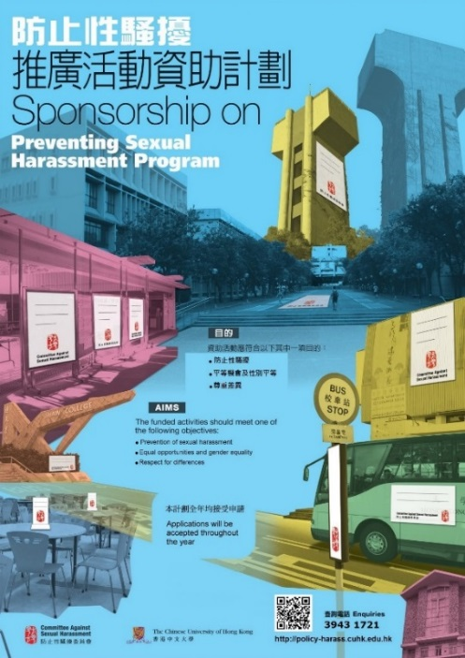
Publicity Materials
Posters
Pamphlets
Leaflets

Slide 15
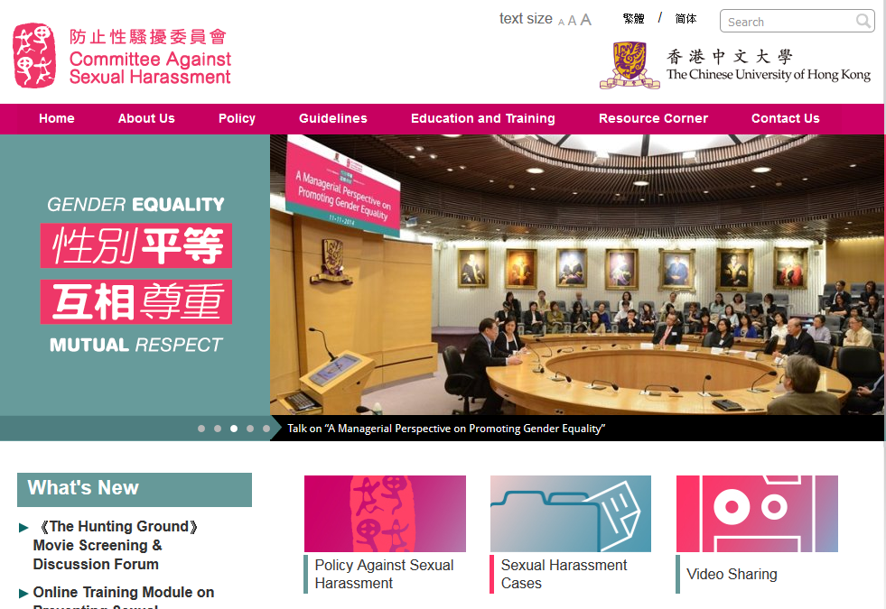
Committee Against Sexual Harassment Website

Slide 16
Thank You

