Slide 1
A Campus of Gender Equity
Prof. Greta S. P. MOK
Gender Equity Officer

Slide 2
The University of Macau is committed to providing a safe, healthy, and gender-friendly environment for academic and career pursuits, by sharing with all staffs and students the University’s views on professional conducts and gender equity.

Slide 3
Gender Equity
It is essential that all the University members respect one another and the University strives to maintain an academic and work environment that is free from sexual harassment and sexual bullying.
The University has zero tolerance of sexual harassment and sexual bullying and will take prompt legal and disciplinary action where the case is substantiated.

Slide 4
Gender Equity
Sexual harassment is an unwelcome or unwanted conduct of sexual nature, including unwelcome sexual advances, requests for sexual favors, and other verbal, non-verbal, visual, or physical conduct of sexual nature.
Sexual bullying is any coercive behavior or act against somebody, through the use of any tool, technological or otherwise, based on or by taking advantage of their sexuality or gender regardless whether the behavior or act in question is physical, verbal or otherwise and regardless whether it is carried out in their presence or absence.

Slide 5
Stipulations established by UM
The Personnel Statute of the UM Article 12 Obligations of Personnel
1. The obligations of the UM staff members shall be: 1) Respecting and treating with civility both superiors and subordinates, colleagues and all other persons who have relations with UM;
Guidelines on the Professional Conduct for
the Academic Staff of the UM
II. Ethical Commitments
2.2 Deal with students respectfully and fairly without discrimination of any kind.
2.3 Exercise due care for students and pay close attention to their whole person development.
2.10 Avoid placing students in situations which may unnecessarily cause them embarrassment.
Guidelines for Handling Sexual Harassment and Sexual Bullying Cases of the UM

Slide 6
Stipulations established by UM
All related guidelines are in harmony with our educational ideal as conceived in our University Motto –
Humanity, Integrity, Propriety, Wisdom and Sincerity

Slide 7
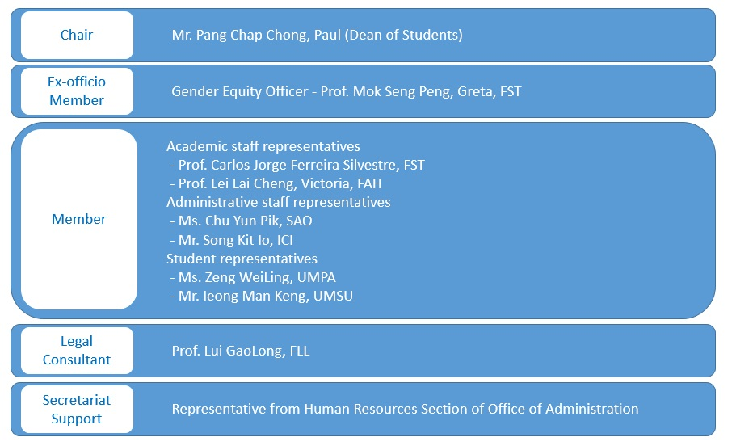
Committee on Gender Equity
Notes:
The Committee on Gender Equity (CGE) was established to promote gender equity in the University. Led by the Rector, the CGE is composed of the representatives of academic staff, administrative staff and students.

Slide 8
Committee on Gender Equity
Terms of Reference
To promote gender equity in the University by way of publicity, education or any other means.
To monitor the situation of gender equity in the University and assist in the investigation and handling of complaints when necessary.
To devise, review and modify the guidelines, for handling the gender equity issues or any other related guidelines.
To assist in instituting and implementing the University’s gender equity initiatives.
Email: gender_equity@umac.mo │ Webpage: http://www.umac.mo/cge

Slide 9
性別平等主任
Gender Equity Officer GE_Officer@umac.mo
__________________________________________________
To provide information and advice to staff members and students with the objective of effecting a gender equity environment on campus;
To entertain formal complaint from any staff member or student who believes that he or she has been or is being sexually harassed or bullied;
To provide the complainant information and advice on the options and procedures of lodging a formal complaint including reporting to the police if the conduct under complaint appears to have constituted a criminal offence;
To require all units in the University to report received complaints and offers advice on handling them. The Gender Equity Officer shall file all the complaints received which meet the required conditions;
To attend the CGE meetings as an ex-officio member.

Slide 10
Protecting yourself and seek help
Say “no” to any sexual harassment or sexual bullying.
Be calm and collect evidence about the incident, seek help and report it immediately.
Try to choose a suitable public place for the one to one meeting with your colleague or student. If not possible, keep the door of the office open or ask to leave it open while the meeting is on.
Notes:
What you can do when facing sexual harassment or sexual bullying:
Say “no” to any sexual harassment or sexual bullying.
Be calm and collect evidence about the incident, seek help and report it immediately to the Committee on Gender Equity, through respective your Unit Head or the Gender Equity Officer.
It is normal that you may feel nervous and helpless when such an incident occurs to you. Seek help from respective unit head, the Gender Equity Officer or someone you can trust.
A friendly tip: Try to choose a suitable public place for the one to one meeting with your colleague or student. If not possible, keep the door of the office open or ask to leave it open while the meeting is on.

Slide 11
Procedures for Lodging Complaints about Sexual Harassment and Bullying
The complainant reports the incident to the Unit Head / Gender Equity Officer verbally or in writing
以書面或口頭形式向部門主管/性別平等專員提出投訴
The Gender Equity Officer receives the complaint
性別平等專員接收投訴個案
The Gender Equity Officer reports the complaint and provides recommendations to the CGE
性別平等專員向性別平等委員會報告投訴個案及提出建議
The CGE conducts a preliminary investigation and provides recommendations to the Rector, who shall decide on the appropriate action to be taken
性別平等委員會進行初步調查，並向校長提出建議，由校長決定應採取之行動
The Gender Equity Officer shall inform the complainant of the decision
性別平等專員應將有關決定通知投訴人
Notes:
For any complaints about sexual harassment and bullying, staff may report the incident to the Gender Equity Officer or Unit Head verbally or in written. Once the Officer receives the complaint, it will be raised to the Committee on Gender Equity with recommendations. The Committee will then conduct a preliminary investigation, and will provide recommendations to the Rector, who shall decide on the appropriate action to be taken. The Gender Equity Officer shall inform the complainant of the decision.
All records and documents related to the complaints will be treated with strict confidentiality.

Slide 12
Reference in Macau Penal Code
Effective from 26 Aug 2017
Sexual harassment (semi-public crime, Article 164-A) & other sexual crimes – newly written into the stipulation
For more information, please visit:
http://bo.io.gov.mo/bo/i/95/46/codpencn/codpen0001.asp
Notes:
性騷擾罪也已於去年正式被引入澳門的刑法典 (第164-A條),屬於半公罪, 經被害人提告可進行刑事訴訟, 所以校園性騷擾行為不謹會被學校處分, 也是犯法, 要負上刑事責任.

Slide 13
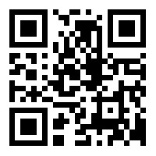
Contact Points
Committee on Gender Equity (CGE)
性別平等委員會
Email: gender_equity@umac.mo
Webpage: http://www.umac.mo/cge
Gender Equity Officer
性別平等專員
Email: GE_Officer@umac.mo
Notes:
For more information about the Guidelines, Complaint Procedures, Tips and other related information on gender equity, please refer to our Pamphlets.

Slide 14
It is all about respect to yourself and others…
Prevention is the Best Policy

Slide 15
UM is a place where we learn, work, and grow together, let’s have a campus of gender equity.
15
Notes:
The bottom line is that UM has zero tolerance for sexual harassment and sexual bullying. So, don’t do it, and report it if it ever happens. Wish you an enjoyable journey at UM! Thank you.

